Slide 1
Low-cost sensors for measuring PM_{2.5}:
Field evaluation, calibration and insights for medium size urban area
Presenter: Giorgos Kosmopoulos
giokosmopoulos@gmail.com
Laboratory of Atmospheric Physics, Department of Physics, University of Patras, 26504 Patras, Greece

Slide 2
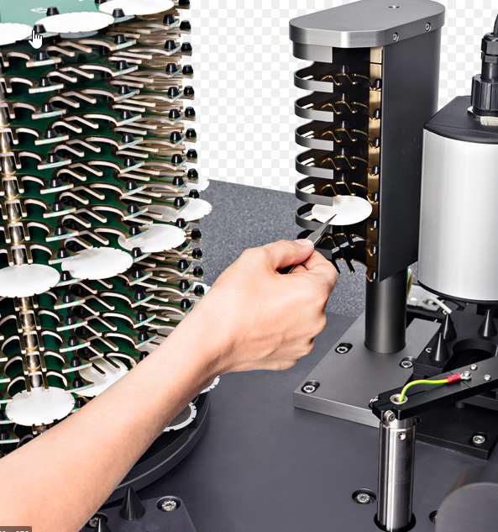
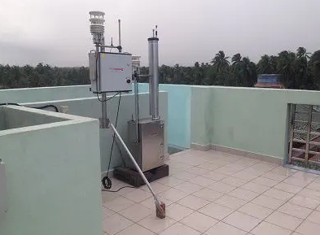
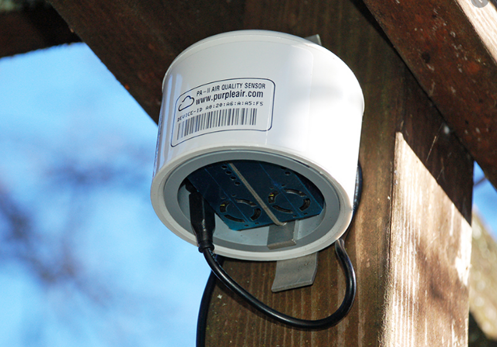
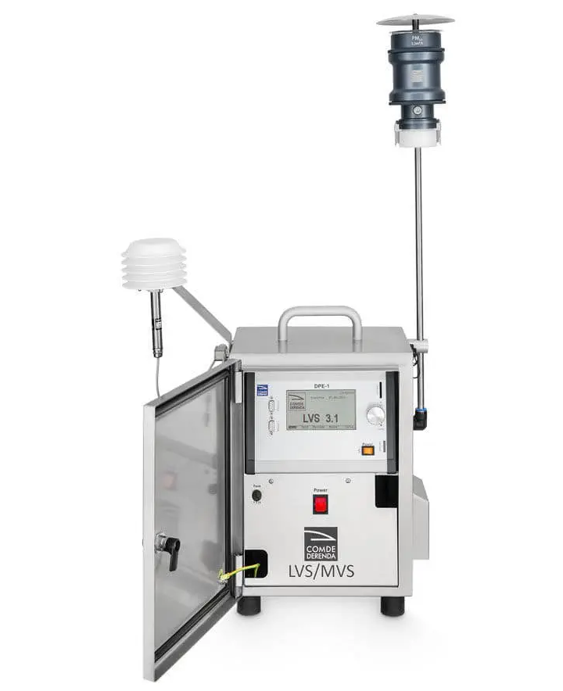
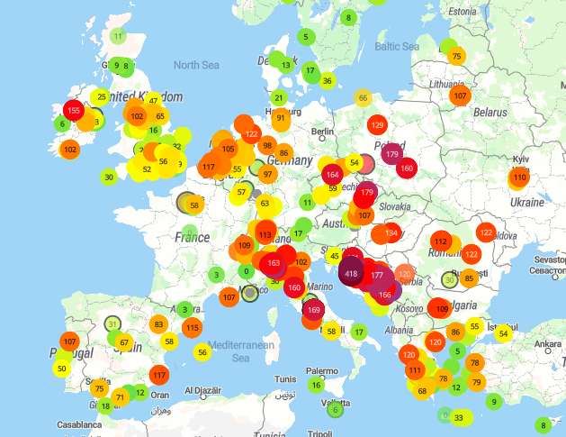
PM measurement techniques
High quality/reference instruments
Low-cost sensors (LCS)
High precision
High costs
Bulk and Heavy
Small, inexpensive
Less precise, calibration needs
Dense networks
https://map.purpleair.com/

Slide 3
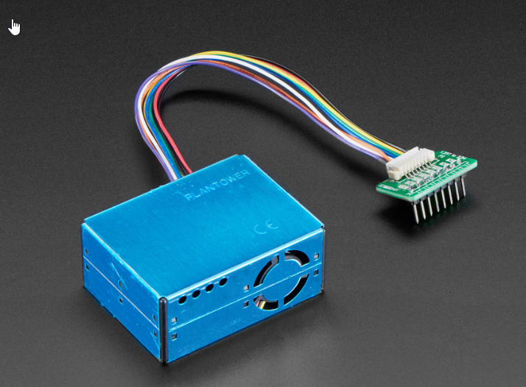
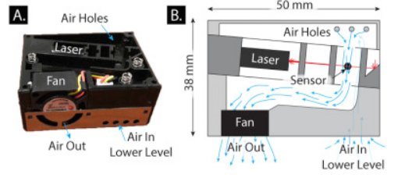
Plantower PMS 5003 sensors
Sayahi et al. (2019). Long-term field evaluation of the Plantower PMS low-cost particulate matter sensors, Environmental Pollution.

Slide 4
PMS 5003 sensors intravariability
y=0.96x-0.32
R²=0.99
Ensure there is no faulty sensors
Evaluate intra-units precision
High data reproducibility between sensors

Slide 5
PMS 5003 sensors calibration and colocation setup
PMS 5003
GRIMM EDM 180
May 2017 - November 2018

Slide 6
PMS sensor calibration
PAir_{2.5, cor} = 0.42 PAir_{2.5} + 0.26 (μg m⁻³)
RME= 17.7% (1.14 μg m⁻³)
RMSE= 24.6% (1.56 μg m⁻³)
G. Kosmopoulos, V. Salamalikis, S.N. Pandis, P. Yannopoulos, A.A. Bloutsos, A. Kazantzidis,(2020)
Low-cost sensors for measuring airborne particulate matter: Field evaluation and calibration at a South-Eastern European site,
Science of The Total Environment,https://doi.org/10.1016/j.scitotenv.2020.141396

Slide 7
Patras PM_{2.5} concentrations insights
Suburban North
Background
Urban North
City Center
COA city center
Urban South
Suburban South
http://patrasair.gr/

Slide 8
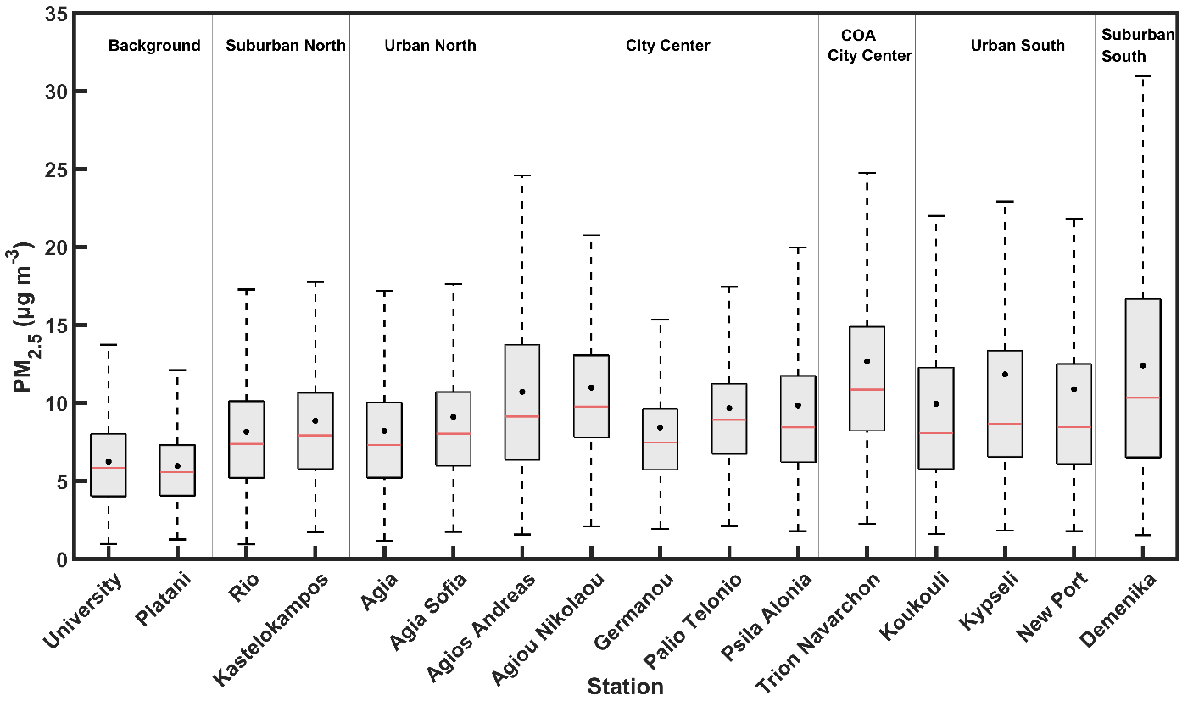
Spatial Variability (02/2017-12/2019)
Boxplots of daily PM_{2.5} concentrations at all stations of the measuring network. The areas of stations are also shown. The black dots and the solid red lines correspond to the mean and median PM_{2.5} concentration. The bottom and top edges of the box indicate the 25th and 75th percentiles.

Slide 9
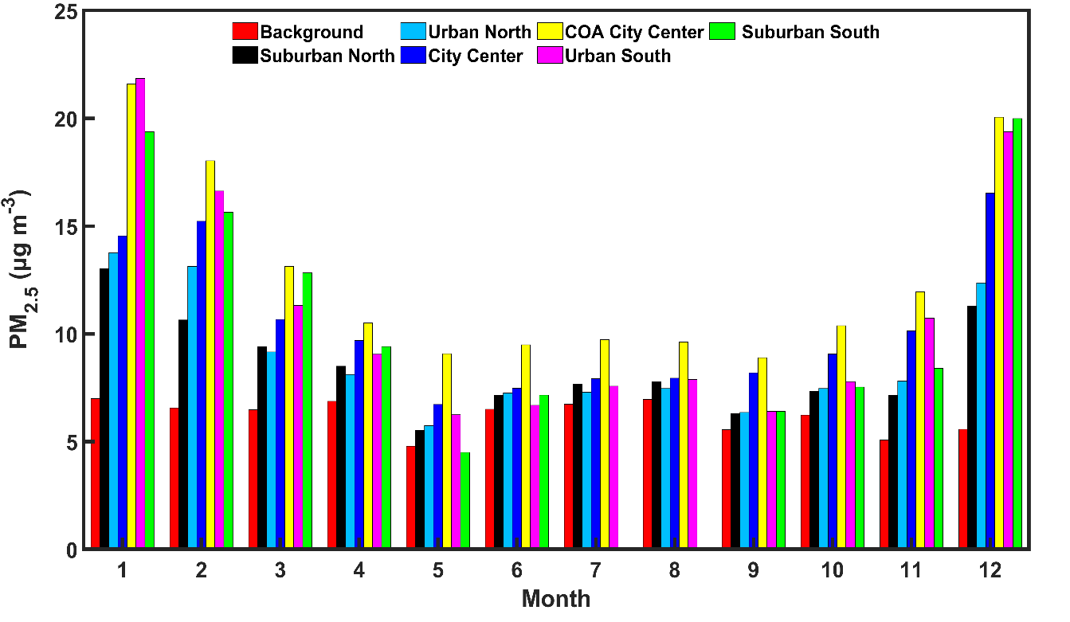
Monthly Variability
Monthly average PM_{2.5} concentrations for all the examined areas across the city during 02/2017-12/2019.
The bar colors represent the examined areas across the city of Patras.

Slide 10
PM_{2.5} Diurnal Variation
Warm Period
Cold Period

Slide 11
Estimation of PM_{2.5} sources contribution
Air quality is affected by local and regional emissions
It is important to estimate the contributions of regional sources
Implementation of a simple observation-based method (OBM) developed by Diamantopoulou et al., 2016 to determine the regional sources contributions in Patras
7.3 μg m⁻³
M. Diamantopoulou, K. Skyllakou, S.N. Pandis, 2016
Estimation of the local and long-range contributions to particulate matter levels using continuous measurements in a single urban background site
Atmos. Environ. https://doi.org/10.1016/j.atmosenv.2016.03.015.

Slide 12
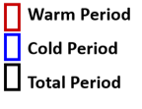
Regional sources contribution
Boxplots of regional to total PM_{2.5} fraction at the 6 examined areas of the measuring network and the Patras city average during the warm (red), the cold (blue) and the total (black) experimental period (02/2017 – 12/2019). The bottom and top edges of the box indicate the 25th and 75th percentiles, respectively.

Slide 13
Monthly averaged Patras PM_{2.5} sources contribution
Monthly averaged estimated PM_{2.5} sources contribution

Slide 14
Conclusions
Traditional in-situ measurement techniques need improvement
Evaluate and calibrate low-cost light scattering sensors
Create dense low-cost PM air monitoring networks
Supplement regulatory monitoring
Increase measurements spatiotemporal resolution
Better insights on urban areas air quality
Understand air pollution sources (local and regional)

Slide 15
Thank you for your attention!!!

