Slide 1
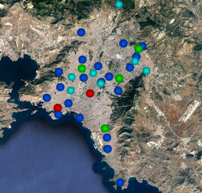
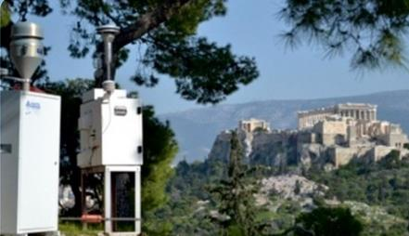
Air quality monitoring through sensor-based networks in large metropolitan areas: The case of Athens, Greece
Dr. Georgios Grivas
Research Fellow, National Observatory of Athens (IERSD/NOA)

Slide 2
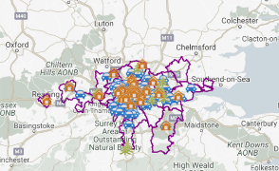
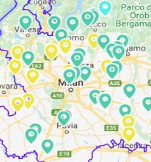
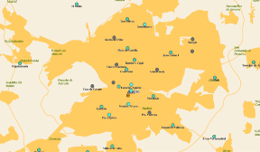
Dense Air Quality Monitoring Networks in major European cities
No. of stations: ≈ 120
No. of stations: ≈ 70
No. of stations: ≈ 50
No. of stations: ≈ 50

Slide 3
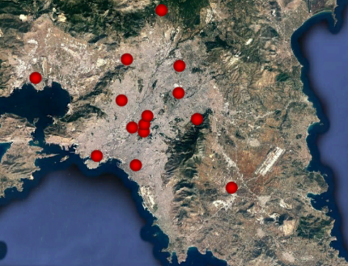
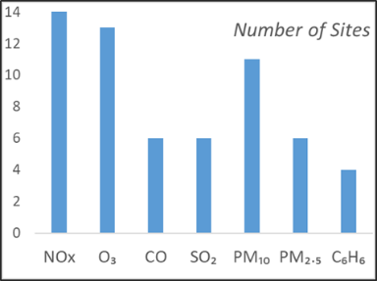
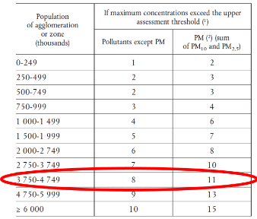
A less dense Air Quality Monitoring Network in a major European City
GREATER AREA OF ATHENS (GAA)
Population: 3.6 mil. (2019 – Eurostat)
Area: 412 km² (Athens Basin)
Regional Units: 8
Municipalities: 56
Population Range: 18-664k (by municipality)
Density Range: 0.1-21.2 k/km2 (by municipality)

Slide 4
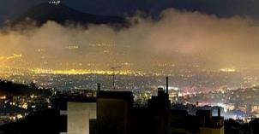
Local factors exacerbating common European AQ issues
Wintertime “smog” due to residential wood-burning
Research studies feature Athens as the biomass-burning capital of the EU
Extreme short-term levels for PM_{2.5} (>200 μgm⁻³, hourly), with high contributions of organic compounds and black carbon
Summertime photochemical smog
High ozone levels with frequent exceedances of alert and information thresholds
The majority of urban background sites in the GAA each year breach the annual EU target-value
Aging vehicle fleet – Surge of diesel-powered cars
A ban on private diesel cars ended in 2011, and they have since dominated new and used-car sales
Greece has one of the most aged vehicle fleets in the EU (4th most aged for private cars, 1st most aged for trucks)
Persistent AQ-standard violations for NO₂, PM₁₀ at traffic sites
Shipping emissions
Piraeus in the GAA is the busiest European passenger port and the 2nd most busy port in the Mediterranean

Slide 5
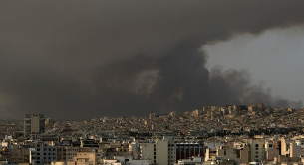
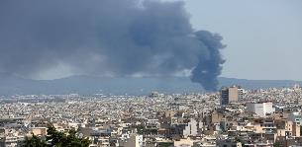
Episodic air quality events aggravate short-term exposure
Wildfire smoke impacting the urban area
The GAA has been affected by emissions from a wildfire event almost every summer since 2017
The impact of the August 2021 wildfire lasted for over a week and led to extreme short-term PM_{2.5} levels (>300 μgm⁻³)
Industrial accidents emitting hazardous pollutants
In the recent years (2016-2020), there have been two large scale industrial accidents in plastic-recycling plants of the GAA
Atmospheric dispersion carried the plumes over the Athens basin, leading to excessive PM levels, characterized by high BC contribution
African dust intrusions
Dust events due to Saharan dust transport are very common in Southern Greece, especially during spring, leading to extreme PM₁₀ levels and also aggravating short-term PM_{2.5} exposure

Slide 6
Identifying the special needs for AQ monitoring in metro areas
Large exposed populations necessitate spatially representative measurements, to capture within-area variability and reduce exposure misclassification error
Large areas mean that atmospheric dynamics can induce substantial intra-urban variability
The heterogeneous urban landscape and source mixture dictate measurement at different site types
Multiple stakeholders at different levels (governmental, regional, municipal, private sector) have different AQ management priorities and require solutions for local issues
Large investments required to expand regulatory network
Episodic events but also increased urban mobility call for near-real time information
Need for IoT integration and personalized exposure information (online platforms, smartphone apps, etc.)
While sensor-based solution will not substitute regulatory AQ monitoring stations for compliance assessment, it is imperative to calibrate their outputs for reliable results
Densify
Downsize
Integrate online
Calibrate

Slide 7
Designing an integrated AQ monitoring network in Athens
Medium-cost AQ monitoring systems (<10000€)
Web Portal
GSM
Wi-Fi
Low AQ monitoring systems(<1000€)
Calibrated Data,
Air Quality Index,
Geospatial Info
Gateway/Controller,
Data Server
Calibration, evaluation
Fixed-site regulatory AQ monitoring
(e.g. NOA - Thissio)
FTP
Smartphone App
Design and implementation of an integrated ΙοΤ network and data-visualization platform
Products and services to inform and protect the public from excessive exposure
Incorporation of other available monitoring networks providing calibrated data

Slide 8
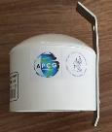
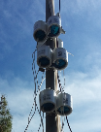
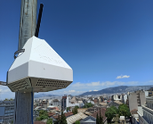
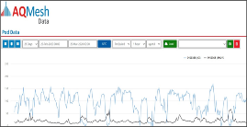
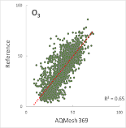
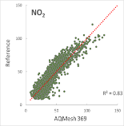
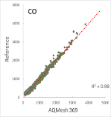
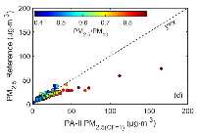
Sensor-based monitoring instruments used by NOA in Athens
Low-cost system for PM_{2.5} monitoring
Multi-pollutant systems for O₃, NO₂, CO and PM
PurpleAir PA-II (PMS5003)
Low cost device, can be deployed in dense networks
Easy to install and operate, transmits data via Wi-Fi to an online platform
Real time monitoring (resolution ≈ 2 min)
Strong correlations with PM_{2.5} reference monitors (except in cases of dust)
AQMesh Multi-pollutant monitor
Alphasense electrochemical sensors for gas measurements, correcting for T interferences
Integrated in a user platform for data access and parametrization (3G transmission, API)
Real time monitoring (min. resolution = 5 min)
Strong correlations with CO, NO₂ and O₃ reference monitors

Slide 9
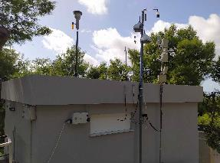
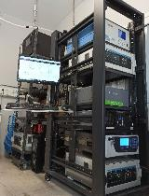
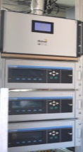
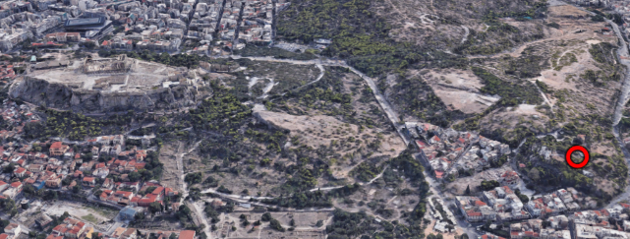
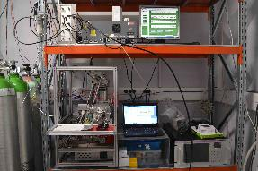
Calibration of sensor-based systems at the NOA supersite
NOA urban background supersite in Thissio, central Athens
Concurrent operation with reference instruments using standard methods
Statistical evaluation of sensor performance
Linear models for correction of sensor outputs
Examination of T, RH effects and cross-pollutant interferences
Periodic calibration of sensors on-site (using golden-pods or the NOA mobile AQ monitoring station)

Slide 10
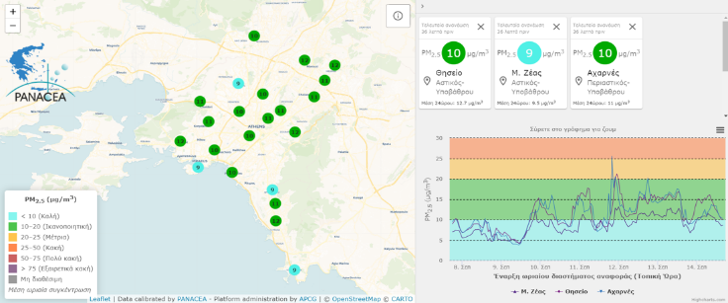
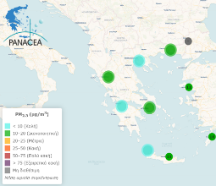
The NOA/PANACEA PM_{2.5} monitoring network in Athens
https://air-quality.gr
PM_{2.5} monitoring in the GAA using low-cost sensors
26 measurement sites in the GAA
≈ 90 measurement sites in Greek cities
(in the framework of RI-PANACEA, with the cooperation of Greek Universities, such as UPatras)

Slide 11
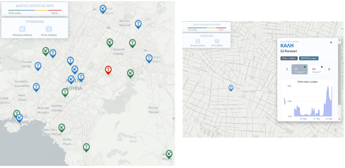
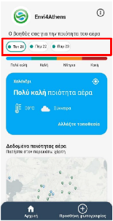
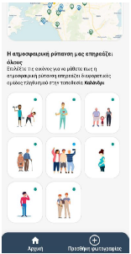
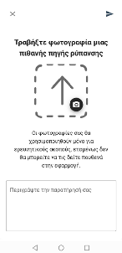
The NOA/EMISSION multi-pollutant monitoring network in Athens
https://emission-web.meteo.noa.gr
O₃, NO_{x}, CO, PM_{x} measurements in the GAA, using AQMesh and custom made low-cost systems
15 measurement sites
in the GAA
Envi4Athens (DRAXIS)
- Smartphone app for the EMISSION network
- Personalized AQI and info - Citizen engagement

Slide 12
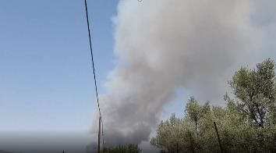
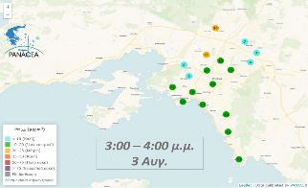
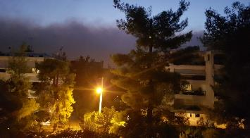
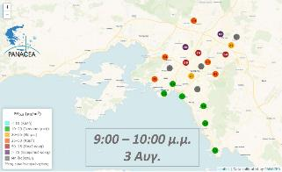
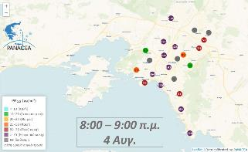
An example: The August 2021 wildfire events
Start
of event
Nearing
the city
Covering
the basin

Slide 13
The utility of a sensor-based network in the context of e-shape
Pilot: S2-P3: EO-based pollution-health risks profiling in the urban environment
Target: Blend EO platforms for AQ with socio-economic and health data, into an integrated risk assessment system to support decision making
Key tools:
High-resolution, city-scale AQ modeling system (see upcoming presentation)
Dynamic population exposure methodology
Health impact assessment tools
Possibilities opened up with AQ monitoring in high resolution
Improved validation and assimilation of the AQ modelling system
Characterization of AQ at the municipality level
Utilization of measurements in land-use regression models for spatial prediction of long-term exposure
Provision of data for improved health impact assessment

Slide 14
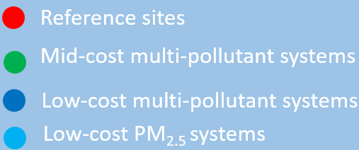
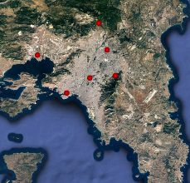
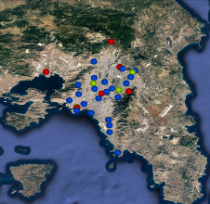
The path to an integrated network of calibrated data
Low-cost multi-pollutant systems
Urban Traffic: 3
Urban Background: 15
Suburban Background: 13
Near-city Rural Background 2
PM_{2.5} network
densification
Aim → Coverage at the municipality level

Slide 15
Thank you !!
ggrivas@noa.gr

