Slide 1
Satellite data for air quality monitoring NO₂ trends during pandemic times in Romania
Maria Ioana VLAD SANDRU
Andi LAZAR
Agentia Spatiala Romana (ROSA)
Air quality monitoring and management
EO4GEO workshop
December, 17th, 2021
Online event
‹#›
Notes:
‹#›

Slide 2
Outline of the presentation
Introduction – air pollution general facts
Bucharest city ranking
National Network for Air Quality Monitoring
Source of pollution in Bucharest
Satellites for Air Quality
Copernicus Atmosphere Monitoring Service
NO₂ data from Sentinel 5P during coronavirus outbreak in Romania
Conclusions
‹#›
Notes:
‹#›

Slide 3
Introduction
Air quality directly affects the lives of most European citizens.
Air pollution rapidly increases the risk of environmental health problems, affecting society in all parts of the developed and developing worlds.
‹#›

Slide 4
Introduction
The European Environment Agency reports that around 90% of city inhabitants in Europe are exposed to dangerous air pollutants.
Accurately measuring and monitoring air quality is vital to raise awareness towards improving the air we breath. Thus, the United Nations Sustainable Development Goals raise the need to make cities and human settlements inclusive, safe, resilient and sustainable.
‹#›
Notes:
‹#›

Slide 5
Air quality Bucharest city ranking
‹#›

Slide 6
National Network for Air Quality Monitoring
‹#›

Slide 7
Sources of pollution in Bucharest
‹#›

Slide 8
Source of pollution in Bucharest Illegal waste burning
© aerlive.ro
© aerlive.ro
More information on https://aerlive.ro/stop-arderilor-de-deseuri/
‹#›
Notes:
‹#›

Slide 9
Environmental impact of NOx
‹#›

Slide 10
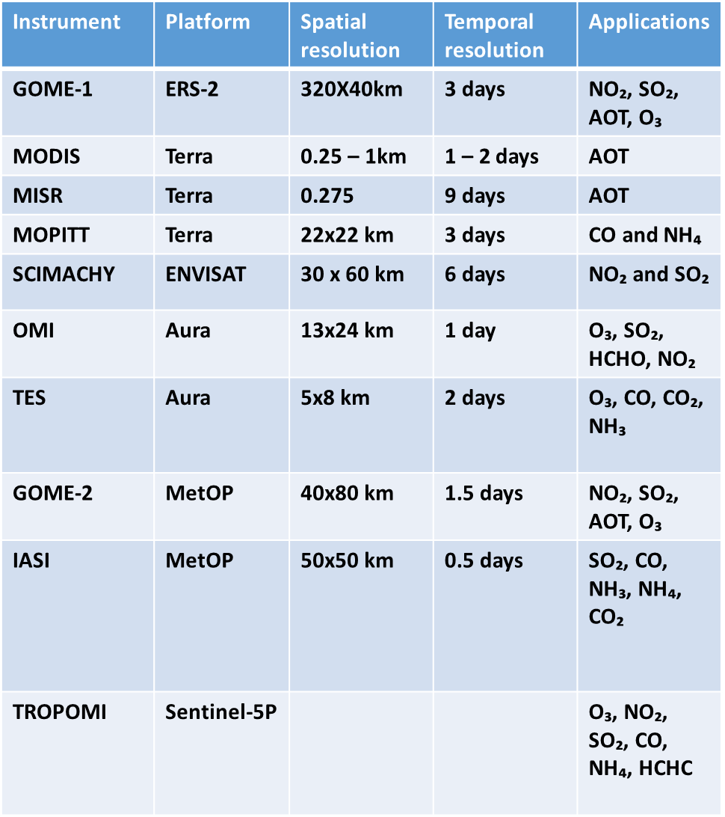
Satellites for Air Quality Major platform and instruments
‹#›

Slide 11
Copernicus Atmosphere Monitoring Service (CAMS)
CAMS provides continuous data and information on atmospheric composition
Operated by ECMWF
EUMETSAT supports CAMS - provision of data and products from its own Meteosat and EPS/Metop satellite systems (e.g. ozone, carbon monoxide and other trace gases, aerosols).
Operational information services for policy makers, citizens
Near –real time services : local air quality, health warning, aviation routing, resources for evaluating possible emission control measures, retrospective assessment of air quality, maps and data for regional air quality forecasts.
Assessments : improve understanding of processes, validate chemical transport models, ground measurement network
Uses observation from current satellites, including Sentinel 5P
‹#›

Slide 12
Copernicus dedicated atmospheric satellite missions
In support of CAMS, several dedicated missions are developed in Copernicus:
• Sentinel-5 Precursor Mission
• Sentinel-4 Mission
• Sentinel-5 Mission
• CO2M Mission
‹#›

Slide 13
The Sentinel Missions for Copernicus Atmosphere Services
‹#›

Slide 14
Sentinel-5 precursor
ESA Sentinel-5 Precursor is a precursor mission that focuses on global observations of the atmospheric for air quality and climate.
Sentinel 5p bridges the data gap between SCIAMACHY/OMI (2002/2004) and Sentinel-5, with improved sensitivity and smaller ground sampling distance.
The TROPOspheric Monitoring Instrument (TROPOMI) is the payload of the S-5p mission and is jointly developed by The Netherlands and ESA.
Spatial sampling : 5.5 x 3.5 km
Mission life time : 7 years
Launched in October 2017.
‹#›

Slide 15
S-5P data products
Aerosol absorption index – aerosol density, related to dust outbreaks, volcanic ash, biomass burning
Carbon monoxide (CO) – combustion of fossil fuels, biomass burning, atmospheric oxidation of methane and other hydrocarbons
Cloud fraction
Formaldehyde (HCHO) – intermediate gas, eventually to CO₂
Nitrogen dioxide (NO₂) – combustion of fossil fuels, biomass burning
Ozone (O₃) – ozone layer, greenhouse gas
Sulfur dioxide (SO₂) – combustion fossil fuels, volcanic ash
‹#›

Slide 16
Spatial Footprint
‹#›

Slide 17
European Air Quality information in support of the COVID-19 crisis
‹#›
Notes:
‹#›

Slide 18
Google Earth Engine
According to https://github.com/samapriya/Earth-Engine-Datasets-List, as of December 2021, there are more than 800 data sets available on the platform.
‹#›

Slide 19
Google Earth Engine Cloud computing platform
Markert, K.N; et al. Historical and Operational Monitoring of Surface Sediments in the Lower Mekong Basin Using Landsat and Google Earth Engine Cloud Computing. Remote Sens. 2018, 10, 909
‹#›
Notes:
‹#›

Slide 20
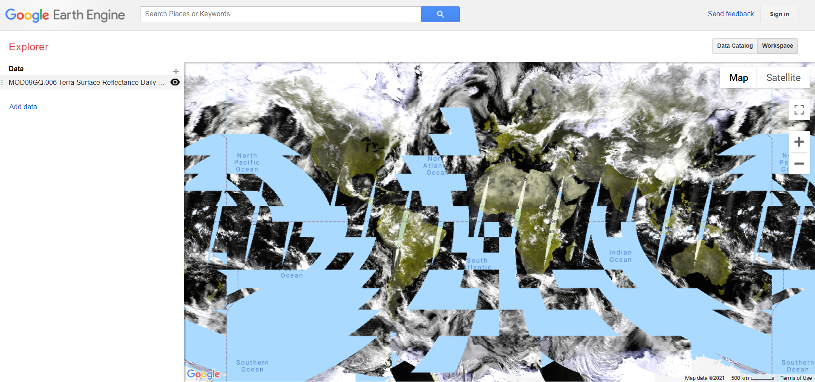
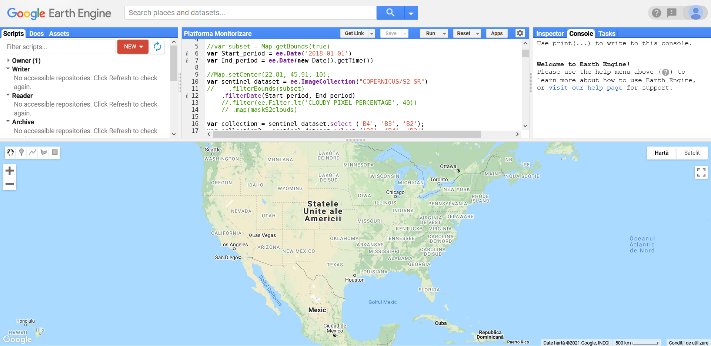
Explorer vs Code Editor
‹#›
Notes:
‹#›

Slide 21
Creating a script in Code Editor
‹#›

Slide 22
Results Tropospheric NO2 evolution before and during COVID-19 lockdown in Romania
‹#›
Notes:
‹#›

Slide 23
Conclusions
•CAMS provides real-time consistent and quality-controlled information related to air pollution and health, everywhere in the world on a daily basis.
•Sentinel-5P’s abilities enable us to detect atmospheric gases and air pollutants more accurately and at higher temporal frequency than ever before at a global scale.
•Google Earth Engine (GEE) provides a free-to-use platform for Earth science data and analysis, suitable for processing air quality satellite data.
•GEE can process large geospatial datasets with global coverage, images can be sorted or filtered using spatial and temporal settings without a need to download a large number of images, additionally, a variety of processing techniques or spatial algorithms can be implemented on data through code editor.
•Satellite data show a reduction of NO₂ in the atmosphere under the strict lockdown period influenced by restricted human mobility, reduced industrial production and transportation controls which were observed throughout Covid19 pandemic lockdown in Romania.
•The present case study supports and reinforces several concepts and skills part of the EO4GEO Body of Knowledge.
‹#›

Slide 24
Maria Ioana Vlad Sandru ioana.vlad@rosa.ro
Andi Lazar
Andi.lazar@rosa.ro
‹#›

