Slide 1
Air quality monitoring and management Workshop High resolution spatio-temporal modeling of air quality based on empirical-statistical approaches
Giorgio Cattani
Italian National Institute for Environmental Protection and Research
Department for Environmental Evaluation, Control and Sustainability
Air quality monitoring unit

Slide 2
Premature death
world wide:
4.2 milions
Population exposed over the WHO guidelines: 91%
The burden of disease attributable to air pollution is now estimated to be on a par with other major global health risks such as unhealthy diet and tobacco smoking
the single biggest environmental threat to human health
Europe premature death: 452.400
Italy premature death: 65.700
PM_{2.5}: 52.300
NO₂: 10.400
O₃: 3.000
Source: EEA, 2020; WHO, 2021
Notes:
From smog hanging over cities to smoke inside the home, air pollution poses a major threat to health across the globe. Almost all of the global population (99%) are exposed to air pollution levels that put them at increased risk for diseases including heart disease, stroke, chronic obstructive pulmonary disease, cancer and pneumonia. WHO monitors the exposure levels and health impacts (i.e. deaths, DALYs) of air pollution at the national, regional and global level from ambient (outdoor) and household air pollution.

Slide 3
Assessing health effects of air pollution (epidemiological studies)
Assess general population exposure at local (urban or neighborhood) regional or continental scale:
spatially resolved data
Long term exposure:
long lasting time series
Short term exposure seasonal and daily variability:
temporally resolved data

Slide 4
Lack of fine spatial and temporal resolution in air pollution assessment: main drawback of most epidemiological investigations
downward bias in health effect estimates due to misalignment between monitors and individual exposures
studies on short-term effects based on monitoring networks can be only implemented in areas with good coverage, e.g. cities
fail to capture differential sub-annual contrasts over space (e.g. seasonal exposures during pregnancy and maternal or birth adverse outcomes)
Notes:
One main drawback of most epidemiological investigations is the lack of fine spatial and temporal resolution in air pollution assessment. Time-series study designs commonly use data available from routine monitoring networks, and rely on the simplistic assumption that daily variability in air pollution exposure is captured by averages across monitors. When spatial contrasts differ day-by-day across locations (as within urban areas or between urban and suburban/rural settings), such assumption may introduce downward bias in health effect estimates due to misalignment between PM monitors and individual exposures.
Furthermore, studies on short-term effects based on monitoring networks can be only implemented in areas with good coverage, e.g. cities, whereas there is a need of investigating PM-related health effects in rural areas or in municipalities close to main industrial plants
Most of the cohort studies assessed long-term air pollution exposure as annual average concentrations at the individual address level, based on inverse-distance weighting (simple kriging) procedures, LUR models (a form of universal kriging which incorporates information from spatial parameters), or dispersion and chemical transport models All these approaches have been shown to provide reliable maps, but are usually limited to annual averages estimation and fail to capture differential sub-annual contrasts over space. These might be important in relation to health endpoints whose relevant exposure window is shorter than a year, such as seasonal exposures during pregnancy and maternal or birth adverse outcomes

Slide 5
General statistical modelling approach
Find a statistically significant relationships between the target variable (i.e. the pollutant concentrations) and several spatial and temporal (or both) predictors (explanatory variables)
Based on this relationship estimate on the whole interest domain the target variable (known the predictors and the model coefficients values).
To build the statistical model we need:
Reliable concentrations data at large number of monitoring stations
Capture the spatial variability within the study domain (monitoring stations position)
Explanatory variables datasets for each sampling points and domain's cell grid

Slide 6
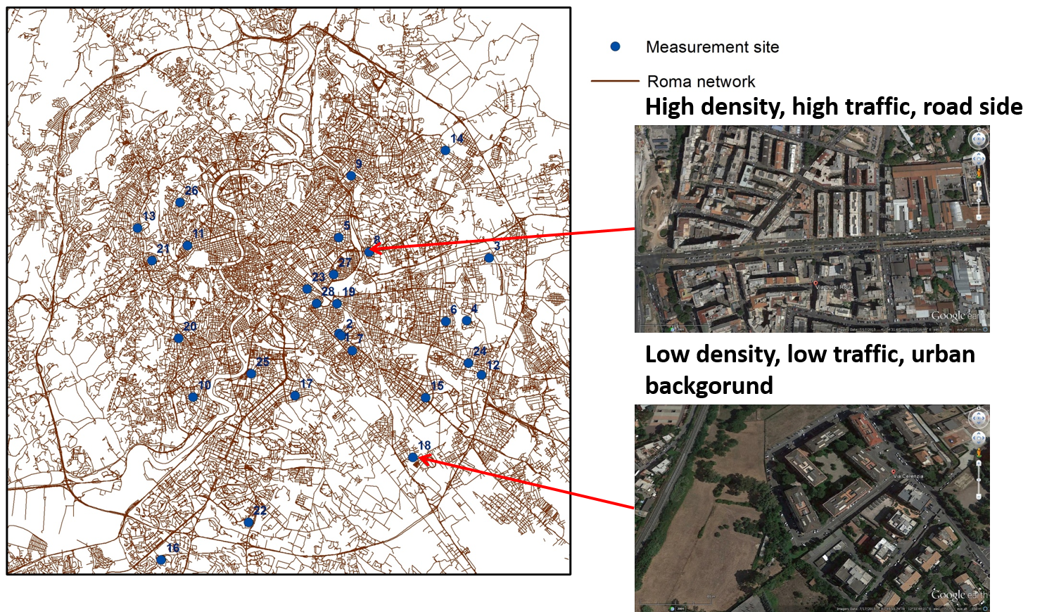
Example statistical framework: multiple linear regression (Land Use Regression models) – urban scale
spatially resolved modelling at local scale (e.g. cities)
When monitoring network are lacking (e.g. ultrafine particles)
Well standardised methodology (ESCAPE project: https://cordis.europa.eu/project/id/211250/it
Notes:
The health effects of long-term exposure to ultrafine particles (UFPs) are poorly understood. Data on spatial contrasts in ambient ultrafine particles (UFPs) concentrations are needed with fine resolution. To assess the spatial variability of total particle number concentrations (PNC, a proxy for UFPs) in the city of Rome, Italy, the land use regression (LUR) models approach was used, and the correspondent exposure of population here living were assessed. To this purpose PNC were measured using condensation particle counters at the building facade of 28 homes throughout the city. Three 7-day monitoring periods were carried out during cold, warm and intermediate seasons. Geographic Information System predictor variables, with buffers of varying size, were evaluated to model spatial variations of PNC. A stepwise forward selection procedure was used to develop linear regression model according to the European Study of Cohorts for Air Pollution Effects project methodology. Other variables were then included in more enhanced models and their capability of improving model performance was evaluated.

Slide 7
PNC annual concentration levels (particles/cm³) estimated from the LUR model
Model predictors:
- traffic intensity on major roads
- Population density
- Urban green density
- building and street configuration
Cattani, G., Gaeta, A., Di Menno Bucchianico, A., De Santis, Gaddi, R., Cusano, M., Ancona, C., Badaloni, C., Forastiere, F., Gariazzo, C., Sozzi, R., Inglessis, M., Silibello, C., Salvatori, E., Manes, F., Cesaroni, G., 2017. Development of land-use regression models for exposure assessment to ultrafine particles in Rome, Italy. Atmospheric Environment 156, 52–60.
Notes:
The enhanced model 2 was then selected as the best performing model to estimate annual average of surface PNC concentrations
The developed models showed that local variations of PNC in the study area can be largely explained by traffic intensity on major roads, accordingly with previous spatial variability assessment studies carried out in Rome for other traffic related pollutants. Population and urban green density were also important predictors of UFP.

Slide 8
Why spatio-temporal statistical models at regional scale?
compared to regional scale deterministic models, statistical models are generally easier to implement
possibility to include complex correlation structures, via easy-to-specify random effects at a low computational cost
require medium sized computing resources
provide higher resolution spatial predictions
Allow to capture the small scale spatial variability around main source (e.g. hot spot at high traffic sites)
Provide sufficient temporal resolution (daily) for epidemiological studies purpose

Slide 9
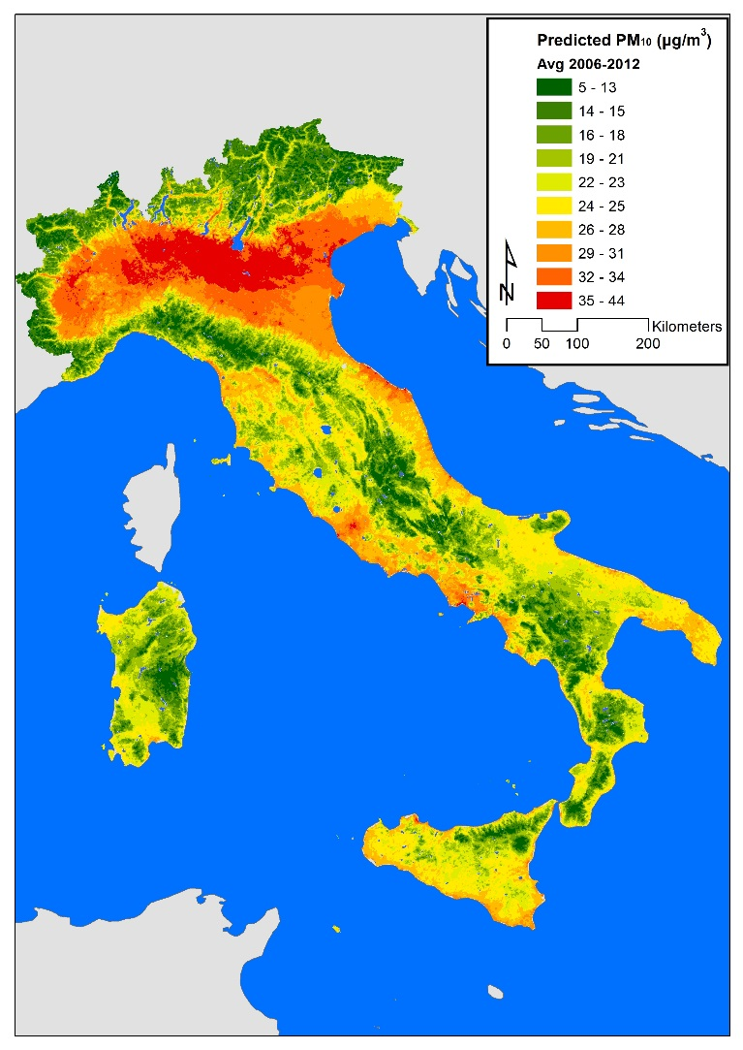
National scale statistical spatio-temporal modeling: the linear mixed model (LMM) frequentist approach
Explanatory variables
Meteorological (ERA5)
Land use (CORINE)
Target variable
Daily PM10 mass concentration
Emissions (ISPRA)
Aerosol Optical Depth (NASA)
Street network (OPEN STREET)
Dust events (BSC-NMMB)
Stafoggia, M., Schwartz, J., Badaloni, C., Bellander, T., Alessandrini, E., Cattani, G., De' Donato, F., Gaeta, A., Leone, G., Lyapustin, A., Sorek-Hamer, M., Hoogh, K. de, Di, Q., Forastiere, F., Kloog, I., 2017. Estimation of daily PM10 concentrations in Italy (2006-2012) using finely resolved satellite data, land use variables and meteorology. Environment international 99, 234–244.
Notes:
We developed a four-staged mixed-model framework to estimate daily concentrations of PM₁₀ (2006-2012) at 1-km² resolution over Italy (approximately 300,000 km²). In particular, AOD data were first calibrated to PM₁₀ concentrations, while adjusting for land-use and meteorological variables (stage 1), the resulting model was then applied to predict daily PM₁₀ over cells-days with (stage 2) or without (stage 3) available AOD. An additional step (stage 4) has been finally applied on each PM monitor to improve stage 1 predictions by capturing local sources of air pollution. To this aim, we assembled a large national geodatabase including spatiotemporal parameters (PM data, AOD, meteorology, PBL, monthly data on Normalized Difference Vegetation Index [NDVI], Saharan dust advection estimates) and spatial predictors (population density, industrial emissions, road networks, land-cover terms, elevation, impervious surfaces) for each 1x1-km cell and day.

Slide 10
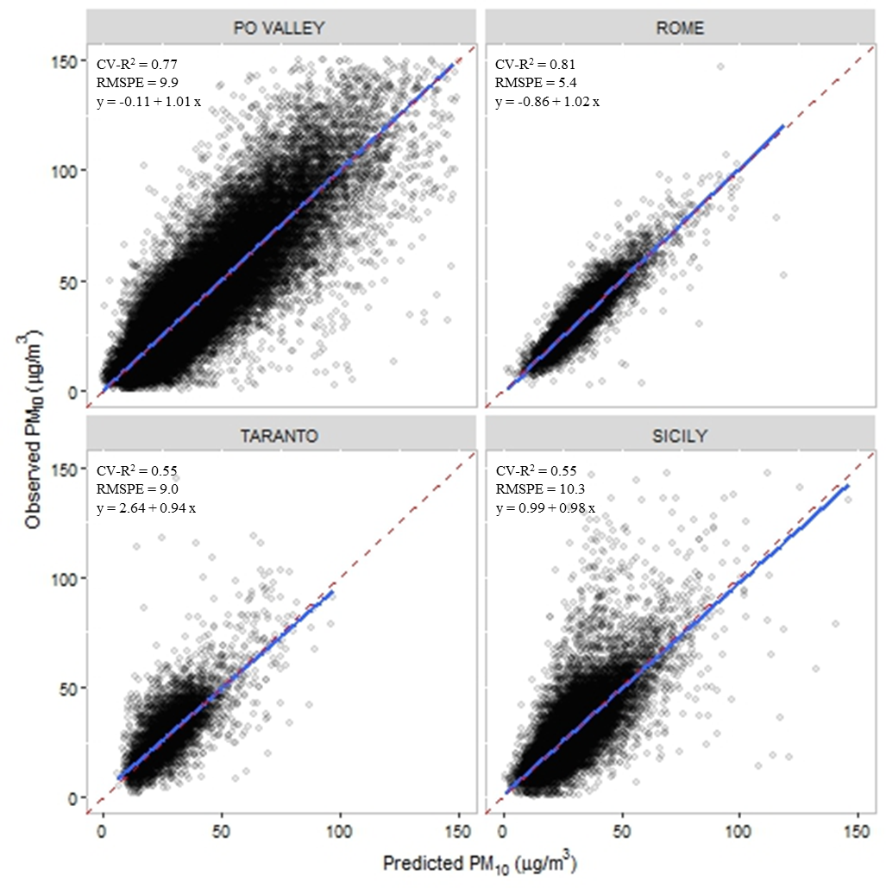
Estimation of daily PM10 concentrations in Italy (2006-2012) using finely resolved satellite data, land use variables and meteorology – model performance
 | Total |  |  | Spatial |  |  | Temporal
 | R² | RMSPE |  | R² | RMSPE |  | R² | RMSPE
Total | 0.72 | 9.0 |  | 0.56 | 5.2 |  | 0.77 | 7.4
By year
2006 | 0.73 | 10.7 |  | 0.58 | 6.0 |  | 0.76 | 9.0
2007 | 0.68 | 10.1 |  | 0.50 | 6.3 |  | 0.74 | 8.1
2008 | 0.75 | 9.1 |  | 0.56 | 5.2 |  | 0.79 | 7.6
2009 | 0.72 | 8.0 |  | 0.53 | 4.9 |  | 0.78 | 6.4
2010 | 0.71 | 7.5 |  | 0.58 | 4.3 |  | 0.76 | 6.2
2011 | 0.75 | 9.5 |  | 0.62 | 5.3 |  | 0.78 | 8.1
2012 | 0.73 | 7.8 |  | 0.58 | 4.4 |  | 0.77 | 6.6
Notes:
Here I presents results comparing observed VS predicted PM₁₀ daily concentrations over time (by year and season) and space (by macro-area and monitor characteristic).
Root mean squared prediction error (RMSPE): it is computed as the square root of the mean quadratic differences between observed and predicted values, and represents a summary measure of the prediction error (on the same scale as PM₁₀, µg/m³);

Slide 11
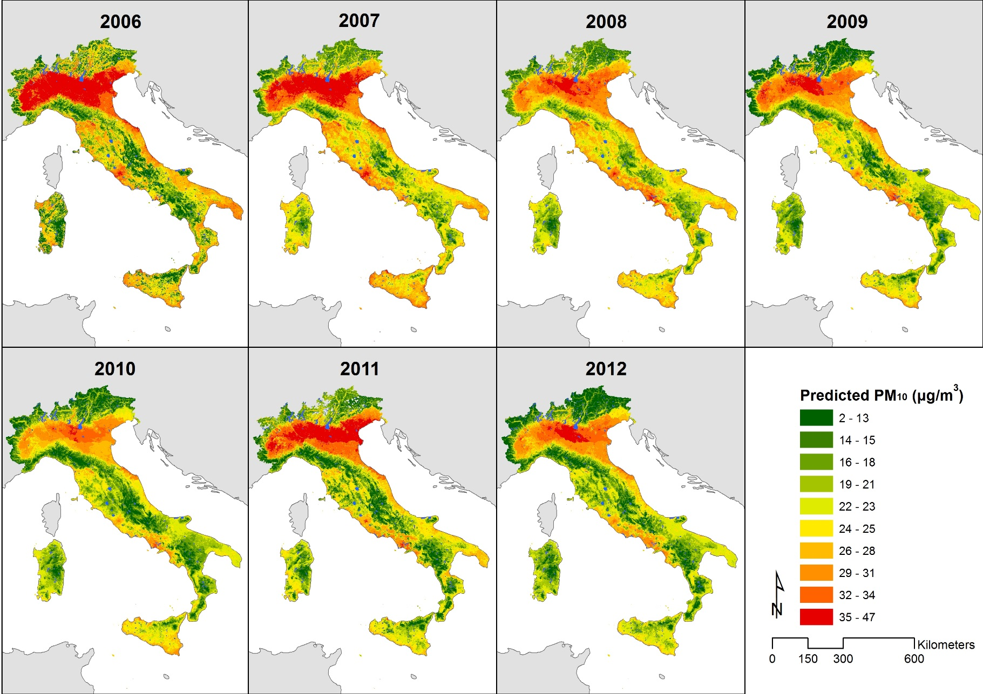
Possible application: trend analysis
Italy 2006-2012: average predicted PM₁₀ by year

Slide 12
LMM drawback
LMM spatial dependence is expressed through discrete random effects that are related to geographic defined areas, resulting in prediction maps with spatial artifact
LMM do not incorporate, in the final product (i.e. the PM10 concentration maps) the whole uncertainty associated with the unknowns (data, parameters, model structure)

Slide 13
Moving to a Bayesian approach: Bayesian hierarchical models using the INLA-SPDE approach
allows to model complex phenomena as a hierarchy of simpler sub-models dealing with the complexity of spatio-temporal processes in a straightforward way.
Covariates as orography or temperature can be used to explain the large scale variability of the phenomenon under study, while residual dependency can be modelled through a space-time process which is usually assumed to be a Gaussian Random Field (GRF).
allows to easily take into account the variability related to models and parameters, thus giving a more realistic picture of the uncertainty of the final estimates
SPDE (Stochastic Partial Differential Equation) approach provides a way to represent a continuous GRF through a discretely indexed Gaussian Markov Random Field Computationally efficient
GRF with a SPDE representation can be fitted in a Bayesian hierarchical framework using the Integrated Nested Laplace approximation (INLA) approach
INLA-SPDE comes with a user friendly R implementation, the r-inla package

Slide 14
Predictors selected
SOURCE | NAME | CODE | UNIT | SPATIAL RESOLUTION
ERA5 | hPbl at 00:00 | pbl00 | m | 30x30km
 | hPbl at 12:00 | pbl12 | m
 | Previous day total precipitation | ptp | mm | 10kmx10km
 | Surface pressure | sp | hPa
 | Average temperature at 2m | t2m | °C
 | Total precipitation | tp | mm
CAMS | Aerosol optical depth at 550 nm | aod550 | nm
NMMB-BSC | Dust intrusion occurrence | dust | 0/1 | 30kmx30km
GMTED | Altitude | q_dem | m | 1km
Open Street Map | Linear distance to nearest high way | d_a1 | m | 1km
CLMS | Imperviousness | i_surface | % | 100 m

Slide 15
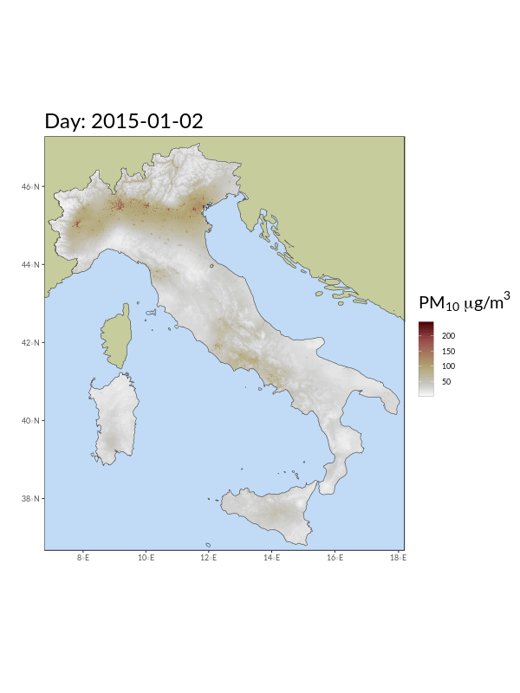
National scale statistical spatio-temporal modeling: the Bayesian (INLA-SPDE) approach
Explanatory variables
Meteorological (ERA5)
Target variable
Daily log[PM10] mass concentration
Aerosol Optical Depth (CAMS)
Street network (OPEN STREET)
Dust events (BSC-NMMB)
Imperiviousness
Altitude
Guido Fioravanti, Sara Martino, Michela Cameletti, Giorgio Cattani. Spatio-temporal modelling of PM10 daily concentrations in Italy using the SPDE approach. Atmospheric Environment 248 (2021) 118192

Slide 16
Validation stage: Agreement between modelled and measured PM10 concentrations.
RMSE (µg/m³) | 4.84 (June) – 13.90 (December)
CORRELATION | 0.71 (July) – 0.91 (February)
BIAS (µg/m³) | 0.22 (August) – 1.07 (January)

Slide 17
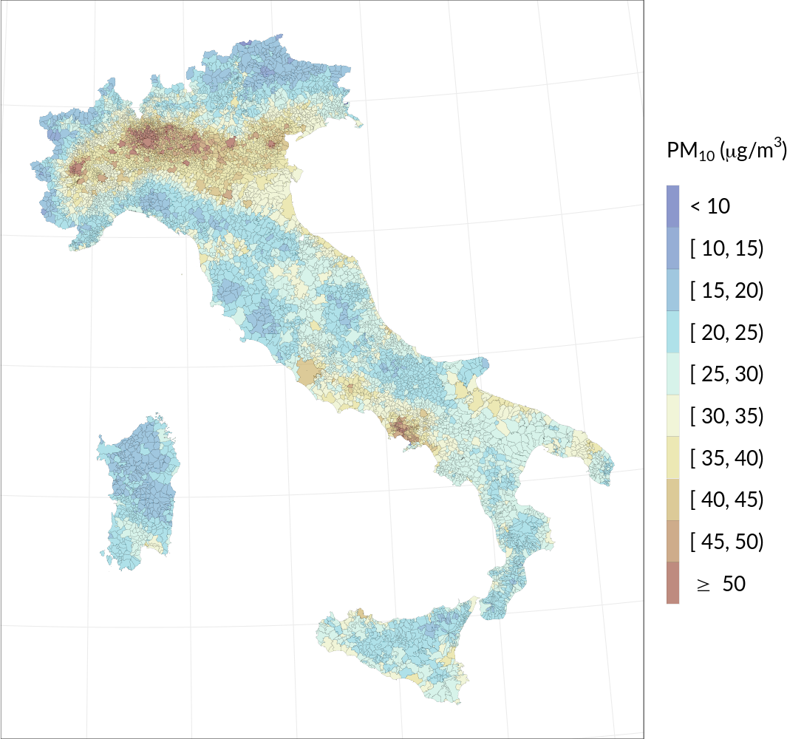
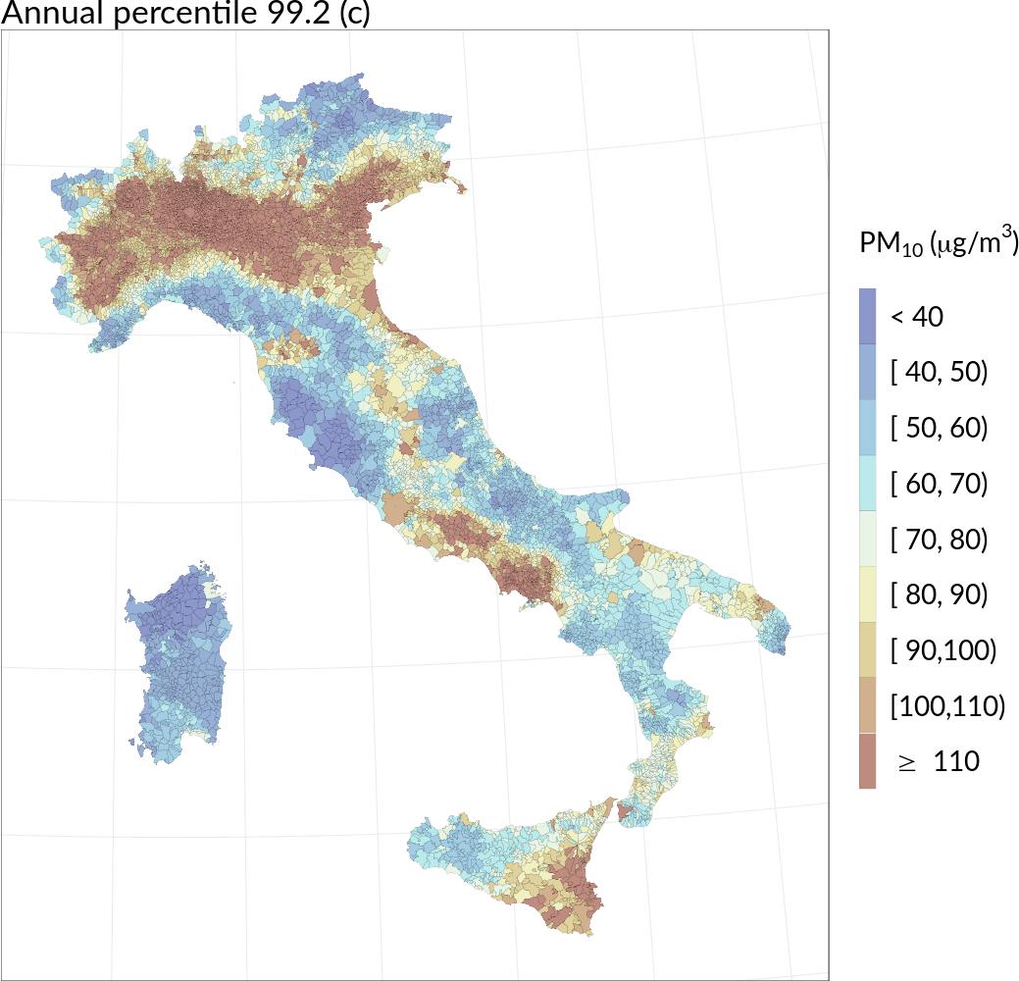
Application: population exposure at municipality level – enhanced spatial coverage and reliability
WHO 2021 recommended AQG = 15 µg/m³ (annual mean)
WHO 2021 recommended AQG = 45 µg/m³ (99 percentile)

Slide 18
Application: PM₁₀ exceedance probabilities (probabilities of PM₁₀ concentrations exceeding the threshold of 50 µg/m³)

Slide 19
Application: intervention analysis A spatio-temporal analysis of NO₂ concentrations during the Italian 2020 COVID-19 lockdown by Guido Fioravanti (PI), Michela Cameletti, Sara Martino, Giorgio Cattani, Andrea Pisoni
assess and quantify - in space and time – the effectiveness of the adopted strategy
take into account the effect of weather and other confounding factor, as well as the spatial and temporal correlation existing in the data and try to evaluate the effect of lockdown intervention continuously in space.
Daily NO₂ concentrations for January-May 2019 and 2020
each month modeled separately
Fitting spatio-temporal model for the differences using the INLA-SPDE approach
Notes:
When a new environmental policy or a specific intervention is taken in order to
improve air quality, it is paramount to assess and quantify - in space and time - the
effectiveness of the adopted strategy. The lockdown measures taken worldwide in
2020 to reduce the spread of the SARS-CoV-2 virus can be envisioned as a policy
intervention with an indirect effect on air quality. In this paper we propose a statistical
spatio-temporal model as a tool for intervention analysis, able to take into account
the effect of weather and other confounding factor, as well as the spatial and temporal
correlation existing in the data. In particular, we focus here on the 2019/2020
relative change in nitrogen dioxide (NO2) concentrations in the north of Italy, for
the period of March and April during which the lockdown measure was in force. We
found that during March and April 2020 most of the studied area is characterized by
negative relative changes (median values around -25%), with the exception of the first
week of March and the fourth week of April (median values around 5%). As these
changes cannot be attributed to a weather effect, it is likely that they are a byproduct
of the lockdown measures. There are two aspects of our research that are equally
interesting. First, we provide a unique statistical perspective for calculating the relative
change in the NO2 by jointly modelling pollutant concentrations time series.
Second, as an output we provide a collection of weekly continuous maps, describing
the spatial pattern of the NO2 2019/2020 relative changes.

Slide 20
Collection of weekly continuous maps, describing the spatial pattern of the 2019/2020 relative change in nitrogen dioxide (NO₂) concentrations in Italy, for the period of March and April during which the COVID-19 lockdown measure was in force
Available at: https://www.pulvirus.it/index.php/obiettivi/obiettivo-1/task-4/
Notes:
We found that during March and April 2020 most of the studied area is characterized by
negative relative changes (median values around -25%), with the exception of the first
week of March and the fourth week of April (median values around 5%). As these
changes cannot be attributed to a weather effect, it is likely that they are a by product
of the lockdown measures. There are two aspects of our research that are equally
interesting. First, we provide a unique statistical perspective for calculating the relative
change in the NO2 by jointly modelling pollutant concentrations time series.
Second, as an output we provide a collection of weekly continuous maps, describing
the spatial pattern of the NO2 2019/2020 relative changes.

